Slide 1
Brief Tutorial on Python
Xiaobai Liu

Slide 2
Why Python
Free
Popular in Industry/Academia
Development community
Source codes available
Easy to use
Variables without declaring
Define classes but are not enforced

Slide 3
Setup
To complete the coding requirement in this class, you need the packages: numpy, scipy, scikit-learn, matplotlib, pandas, pillow, graphviz.
Download and install conda (availables for wnidows, ubuntu, mac)
Installing packages with conda:
conda install numpy scipy scikit-learn matplotlib pandas pillow graphviz python-graphviz

Slide 4
Setup
If you already have a Python environment and are using pip to install packages, you need to run
pip install numpy scipy scikit-learn matplotlib pandas pillow graphviz
If you are using OS X and homebrew, you can brew install graphviz.
If you are on Ubuntu or debian, you can apt-get install graphviz.
Installing graphviz on Windows can be tricky and using conda / anaconda is recommended.

Slide 5
Outline
Part 1: Getting Started
Part 2: Python Commands
Part 3: Examples

Slide 6
1.1 as calculator
$ python
>>> 2*1024
>>> 2**1024
>>> for n in [1,2,3,4,5,6]:
... print n**2
$CTRL-D

Slide 7
1.2 library
>>> from math import sqrt, exp
>>> exp(-1)
>>>sqrt(2)

Slide 8
1.3 Defining functions
>>> def f(x):
… return x*x
>>> f(2)
>>>f= lambda x: x*x
>>>f(2)

Slide 9
1.4 Files
Edit a file “Sfunc.py” with the following lines:
def f(x):
return x*x
>>> from Sfunc import f
>>> f(1.5)

Slide 10
1.5 Scripts
Use an editor to create a file name SayHi.py containing the following lines
#! /usr/bin/ python
print " Hello World!"
print "- From your friendly Python program“
$chmod 755 SayHi.py
$./SayHi.py

Slide 11
Outline
Part 1: Getting Started
Part 2: Python Commands
Part 3: Examples

Slide 12
2.1 Comments
In a .py file:
print " Hello world" # this is silly
""" This is an example of a long comment
that goes on
and on
and on."""

Slide 13
2.2 Numbers and data types
Integers: 5, 23, -75
Floats or floating point numbers: 5.0, - 23.09
Long integer: 1234568901
Check types:
>>>type(-75)
>>>a=3.4
>>>type(a)
Complex numbers
>>> 2j-1
>>>complex(2,3)

Slide 14
2.3 Strings
Single or Double quotes
>>> “this is a string”
>>> ‘This is a string, too’

Slide 15
2.4 Lists and Tuples
Tuple
>>> (1,3,2)
>>> type( (1 ,3 ,2) )
<type ’tuple ’>
Lists
>>> [1 ,”helloo” ,4 ,(1 ,6)]
By nesting lists within lists in this way, we can build up complicated stuctures.

Slide 16
2.5 range
Create lists of integers
>>> range (17)
[0, 1, 2, 3, 4, 5, 6, 7, 8, 9, 10, 11, 12, 13, 14, 15, 16]
>> range (1 ,10)
[1, 2, 3, 4, 5, 6, 7, 8, 9]
>>> range ( -6 ,0)
[-6, -5, -4, -3, -2, -1]
>>> range (1 ,10 ,2)
[1, 3, 5, 7, 9]
>>> range (10 ,0 , -2)
[10 , 8, 6, 4, 2]

Slide 17
6.Boolean values
>>> True
True
>>> type( True)
<’bool ’>type

Slide 18
7. Expressions
Formed from variables, constants, function evaluations, and operators.
>>>2+2
>>> 2**100
>>> f((x-1)/(x+1))

Slide 19
8. Operators
Arithmetic operators: + for addition, - for subtraction, * for multi-plication, and / for division.
>>> 25/3
8
>>>25.0/3
8.3333333333333339
>>>2**(1/2) ???
>>> 5 % 2
1
Other operators: <, >, <=, >=, ==, !=, <>.

Slide 20
9.Variables and Assignments
Variable name: any sequence of letters, numbers, and the underscore (_)
>>> x = 10
>>> x = x + 1
>>> print x

Slide 21
10.Decisions
x = 1
if x > 0:
print " Friday is wonderful"
elif x<-10:
print " Monday sucks“
else:
print no idea”
print " Have a good weekend“
Result?
A. Friday is wonderful
Have a good weekend
B. Friday is wonderful
Line indents

Slide 22
11. Loops
for i in [2, 4, 6, 0]:
print i
else:
print “blastoff”
n = 0
while n < 10:
print n
n = n + 3
loop statements: break, continue

Slide 23
12. Access lists
>>> a = [2, " Jack", 45, "23 Wentworth Ave"]
>>> a[0]
2
>>>a[0] = 2002
>>> len(a)
4
>>>a[2:3]
45
x[:5] is equivalent to x[0:5] and x[2:] is equivalent to x[2:len(x)].
>>> list [18:: -1]
[17 , 16, 15, 14, 13, 12, 11, 10, 9, 8, 7, 6, 5, 4, 3, 2, 1, 0]
>>> [2 ,3 ,6 ,10] + [4 ,0 ,0 ,5 ,0]
[2, 3, 6, 10, 4, 0, 0, 5, 0]
>>> x = [3, 6, 8, 9]
>>> x. append (999)
>>> x
[3, 6, 8, 9, 999]
>>> x = [’a’, ’c’, ’3’, ’d’, ’7’]
>>> x. insert (0 ,100)
>>> x
[100 , ’a’, ’c’, ’3’, ’d’, ’7’]
>>> x. remove (’a’)
>>> x
[100 , ’c’, ’junk ’, ’3’, ’d’, ’7’]
>>>x. pop (0)
100
>>> x
[’c’, ’junk ’, ’3’, ’d’, ’7’]
>>> x. pop()
’7’
>>> x
[’c’, ’junk ’, ’3’, ’d’]

Slide 24
13. Strings
A string is a sequence of characters;
Similar as Lists: starting at 0, slicing, len, concatenation
Immutable: not allowed to change individual chars;
Methods: .capitalize(), .find, .index
>>> a = ’gobbletygook is refreshing’
>>> a. capitalize()
’ Gobbletygook is refreshing’

Slide 25
Outline
Part 1: Getting Started
Part 2: Python Commands
Part 3: Examples

Slide 26
Example-1: Add two Matrices
#addMatrix.py
# Program to add two matrices using nested loop
X = [[12,7,3],
[4 ,5,6],
[7 ,8,9]]
Y = [[5,8,1],
[6,7,3],
[4,5,9]]
result = [[0,0,0],
[0,0,0],
[0,0,0]]
# iterate through rows
for i in range(len(X)):
# iterate through columns
for j in range(len(X[0])):
result[i][j] = X[i][j] + Y[i][j]
for r in result:
print(r)

Slide 27
Example-2: Transpose a Matrix
#transpose.py
# Program to transpose a matrix using nested loop
X = [[12,7],
[4 ,5],
[3 ,8]]
result = [[0,0,0],
[0,0,0]]
# iterate through rows
for i in range(len(X)):
# iterate through columns
for j in range(len(X[0])):
for r in result:
print(r)
Notes:
result[j][i] = X[i][j]

Slide 28
Example-3: Matrix Multiplication
#multiplication.py
# Program to multiply two matrices using nested loops
# 3x3 matrix
X = [[12,7,3],
[4 ,5,6],
[7 ,8,9]]
# 3x4 matrix
Y = [[5,8,1,2],
[6,7,3,0],
[4,5,9,1]]
# result is 3x4
result = [[0,0,0,0],
[0,0,0,0],
[0,0,0,0]]
# iterate through rows of X
for i in range(len(X)):
# iterate through columns of Y
for j in range(len(Y[0])):
# iterate through rows of Y
for k in range(len(Y)):
for r in result:
print(r)
Notes:
result[i][j] += X[i][k] * Y[k][j]

Slide 29
Example-4: Sort a String
#sortString.py
# Program to sort alphabetically the words form a string provided by the user
# change this value for a different result
my_str = "Hello this Is an Example With cased letters"
# uncomment to take input from the user
#my_str = input("Enter a string: ")
# breakdown the string into a list of words
words = my_str.split()
# sort the list
words.sort()
# display the sorted words
print("The sorted words are:")
for word in words:
print(word)

Slide 30
Example-5: Remove Punctuations from a String
# punctuation.py
# define punctuation
punctuations = '''!()-[]{};:'"\,<>./?@#$%^&*_~'''
my_str = "Hello!!!, he said ---and went."
# To take input from the user
# my_str = input("Enter a string: ")
# remove punctuation from the string
no_punct = ""
for char in my_str:
if char not in punctuations:
# display the unpunctuated string
print(no_punct)
Notes:
no_punct = no_punct + char

Slide 31
Example-6: Image Resolution
#imageSize.py
def jpeg_res(filename):
""""This function prints the resolution of the jpeg image file passed into it"""
# open image for reading in binary mode
with open(filename,'rb') as img_file:
# height of image (in 2 bytes) is at 164th position
img_file.seek(163)
# read the 2 bytes
a = img_file.read(2)
# calculate height
height = (a[0] << 8) + a[1]
# next 2 bytes is width
a = img_file.read(2)
# calculate width
width = (a[0] << 8) + a[1]
print("The resolution of the image is",width,"x",height)
jpeg_res("sd.jpg")

Slide 32
Example-7: Read Files
#
import glob
python_files = glob.glob('*.py')
for file_name in sorted(python_files):
print(' ------' + file_name)
with open(file_name) as f:
for line in f:
print(' ' + line.rstrip())
print

Slide 33
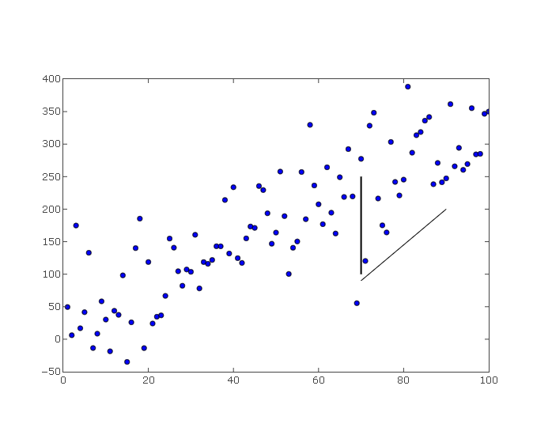
Example-8: Scatters and Lines
#linePlot.py
# visualize data points and lines
import numpy as np
import matplotlib.pyplot as plt
import plotly.plotly as py
line = plt.figure()
np.random.seed(5)
x = np.arange(1, 101)
y = 20 + 3 * x + np.random.normal(0, 60, 100)
plt.plot(x, y, "o")
# draw vertical line from (70,100) to (70, 250)
plt.plot([70, 70], [100, 250], 'k-', lw=2)
# draw diagonal line from (70, 90) to (90, 200)
plt.plot([70, 90], [90, 200], 'k-')
plot_url = py.plot_mpl(line, filename='mpl-docs/add-line')

